Slide 1



PSAS Electric Propellant Feed System
Affiliations: ¹Portland State Aerospace Society, ²Maseeh College of Engineering and Computer Science Portland, OR, 97201, United States

Slide 2
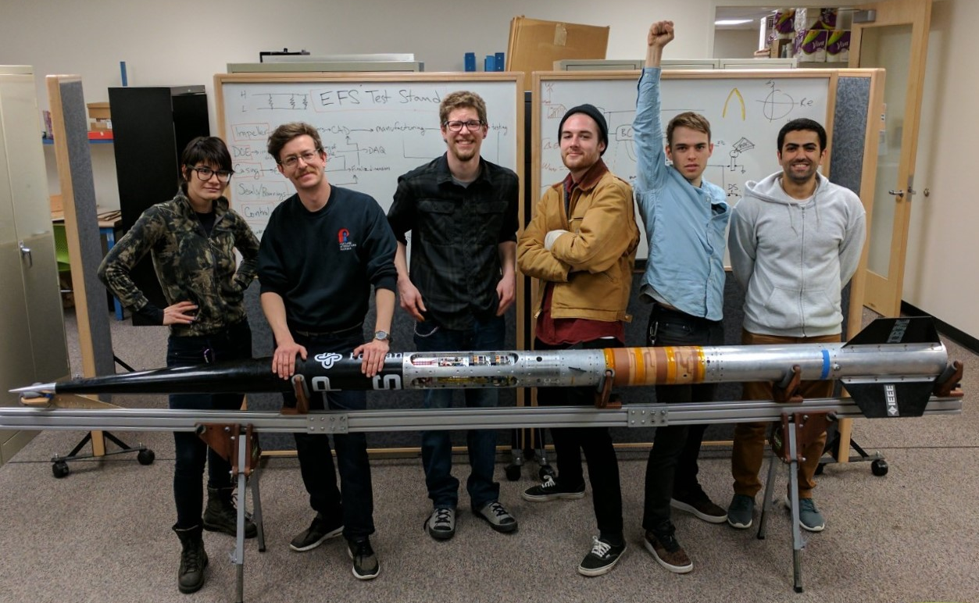
The Team
Team Members (left to right):
Mimi Shang, James Luce, Jorden Roland, Johnny Froehlich, Johnathan Talik, Rawand Rasheed

Slide 3
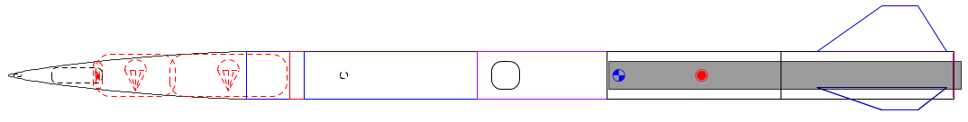

The Problem
Portland State Aerospace Society (PSAS) wants its rockets to go higher, but mass is the enemy:
Δv = change in velocity
V_{e} = exhaust velocity
m_{o} = mass of rocket + propellant
m_{f} = mass of rocket

Slide 4
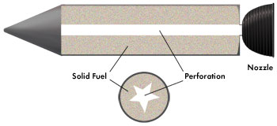
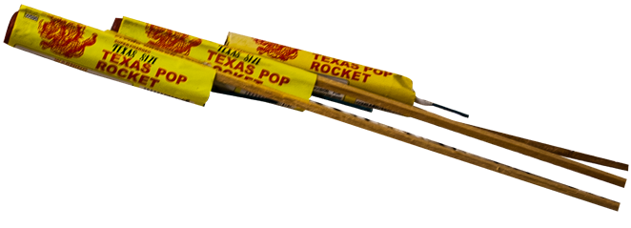
Past approach: solid propellant
Most small rockets use solid propellant.
Simple but inefficient.
Can’t throttle = can’t insert into orbit.
Solid propellant
Nozzle
Grain bore
Solid propellant rocket design
Solid propellant rocket example
Images: http://www.fireworkssupermarket.com, http://www.aerospace.org

Slide 5
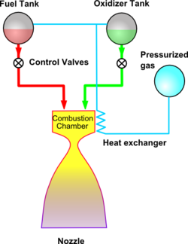
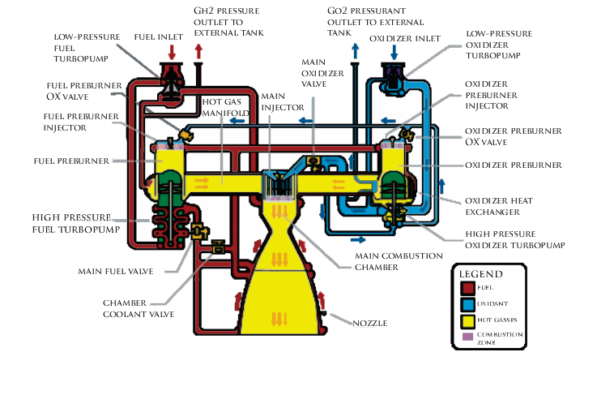
Liquid propellant
Gives more Δv for its mass = goes higher.
Can be throttled = can insert into orbit.
Pressure fed: too heavy
Turbopump: too complex
Images from wikipedia

Slide 6
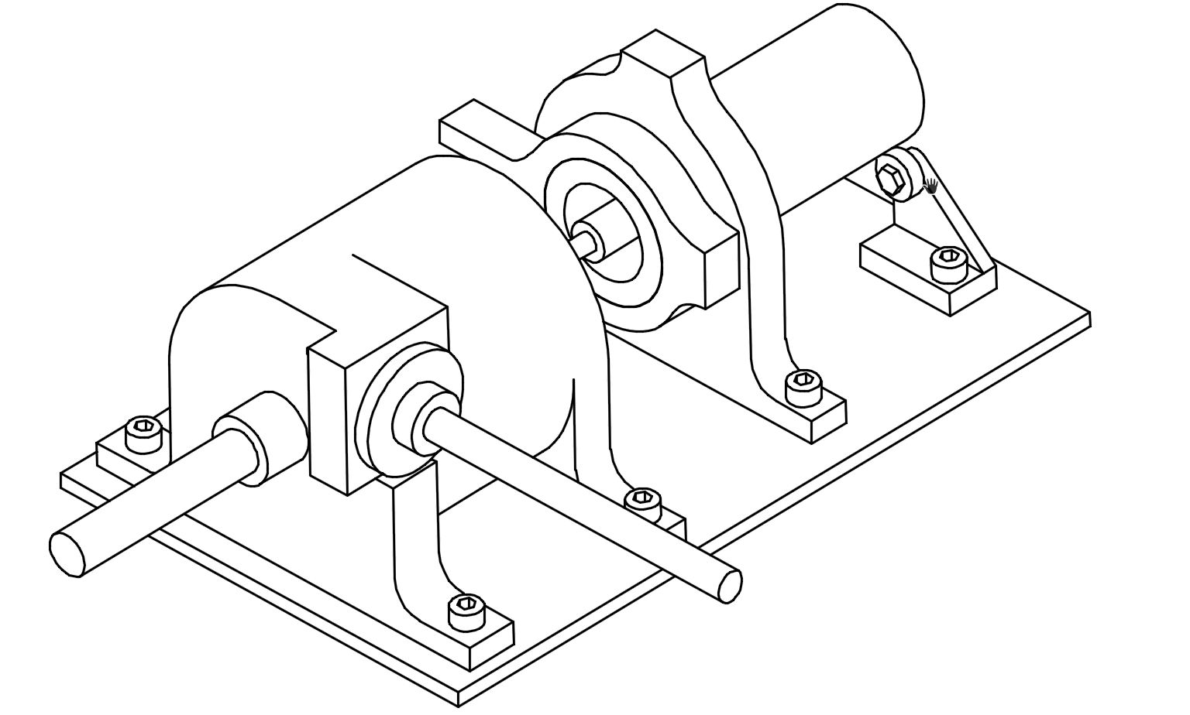
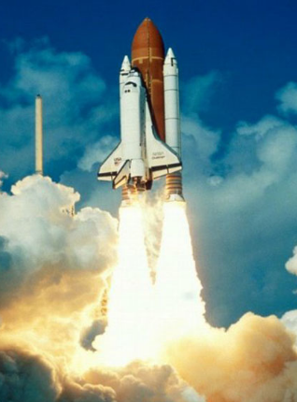
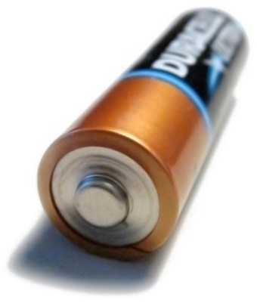
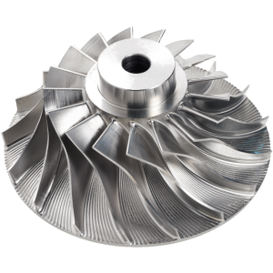
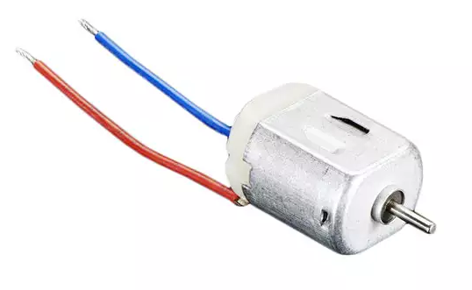
New approach: electric pump
Turbopump without turbine = just a pump.
Battery energy density has been rising.
Lighter than pressure fed, simpler than turbopump.
Electric motor
Pump
Tank
Engine
https://en.wikipedia.org/
http://www.blue-sky-technologies.com/impeller-seal-repair/
https://www.digikey.com/

Slide 7
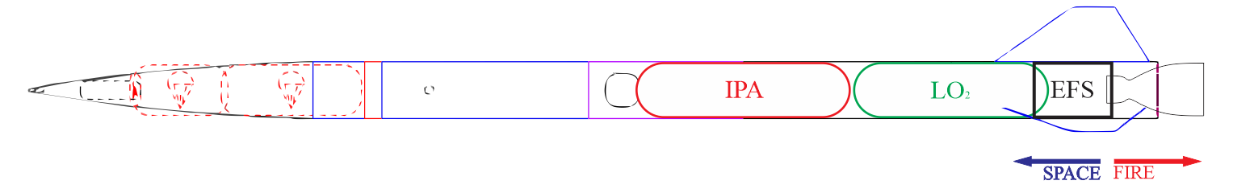
Project Goal
Goal:
Design a test pump to meet PSAS’ requirements.
Test with water (not cryogenic liquid oxygen and isopropyl alcohol).
Performance results will be scaled to design actual rocket pump.

Slide 8
Customer Requirements
Pressure delivery | Must produce discharge pressures of 300-400 psi.
Flow capacity | Must supply a flow rate of ~12 gpm.
Transferability | Documentation must be open source and transferable to future PSAS engineers.
Off-the-shelf components | Must utilize off the shelf components wherever possible.
Cost | Project must be completed for less than $8000

Slide 9
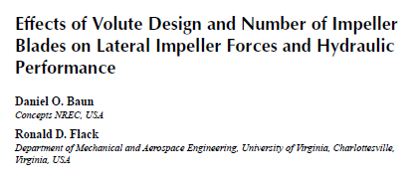

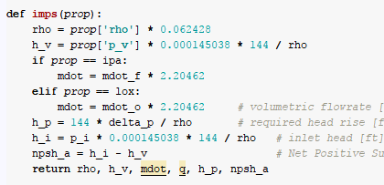





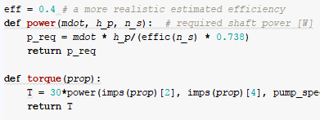




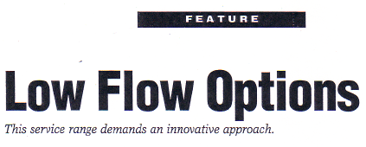

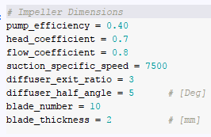



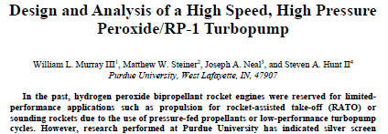


Customer Requirements
Open-ended literature review
Scientific computing
Math is involved
Some
assumptions
Notes:
literature review to narrow the region of interest. (Don’t solve problems we don’t have to)
Scientific computing as an example of using tools to implement theory OR IDEAS. Matercam, SW, Python, Arduino
Allows us to make calculations (OR DESIGNS) over a wide range of values and explore a little.
We can iteratively develop
note:
Guessing is cheaper
If best head coeff is between 0.5 and 1 we use 0.75 ☺

